Slide 1
Hek cell project report
Ningxin Kang
Chen Lab

Slide 2
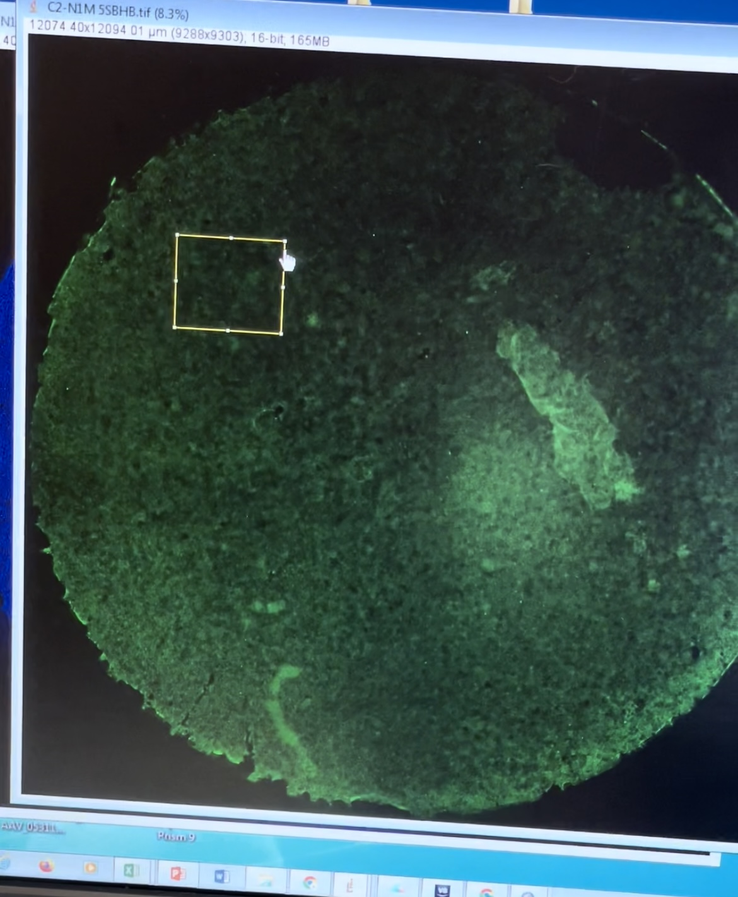
Dataset description
 | BHB Diet | Control Diet | Sum
Number of mouse | 4 | 5 | 9
Number of regions took | 4*4 = 16 | 5*4 = 20 | 36
*Supplementary Discussion 1 over the technical repeats (on Slack):
4 diff regions are selected on one petri dish
They are not replicates, so can be used for increasing statistical power

Slide 3
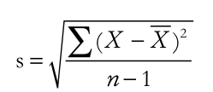
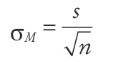
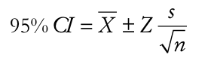
*Supplementary Discussion 2 over SD vs SEM vs CI (During Oct 6 meeting):
Standard Deviation (SD) tells us the dispersion of individual observations about the mean.
Standard Error of Mean (SEM/SE) is the standard deviation of the mean of random samples drawn from the original population.
Confidence Interval (CI) is the range of values that is believed to encompass the actual (“true”) population value.
“The use of SEM should be limited to computing CI which measures the precision of population estimate.”
“Rule 4: because experimental biologists are usually trying to compare experimental results with controls, it is usually appropriate to show inferential error bars, such as SE or CI, rather than SD. However, if n is very small (for example n = 3), rather than showing error bars and statistics, it is better to simply plot the individual data points.”
SD
SEM/SE
Notes:
SD tells us dispersion of individual observations about the mean. a low SD signifies less variability while high SD indicates more spread out of data.
Sample mean ( X ) estimates the true but unknown population mean (μ) and sample SD (s) estimates population SD (s).
However, the precision with which sample results determine population parameters needs to be addressed.
SEM is the standard deviation of mean of random samples drawn from the original population.
This shows that SEM is a measure of the precision with which sample mean X estimate the population mean μ. The precision increases as the sample size increases
However, SEM by itself doesn’t convey much useful information. Its main function is to help construct confidence intervals (CI).
Use of SEM should be limited to compute CI which measures the precision of population estimate.

Slide 4
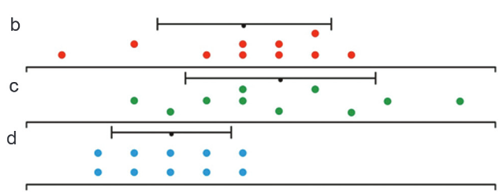
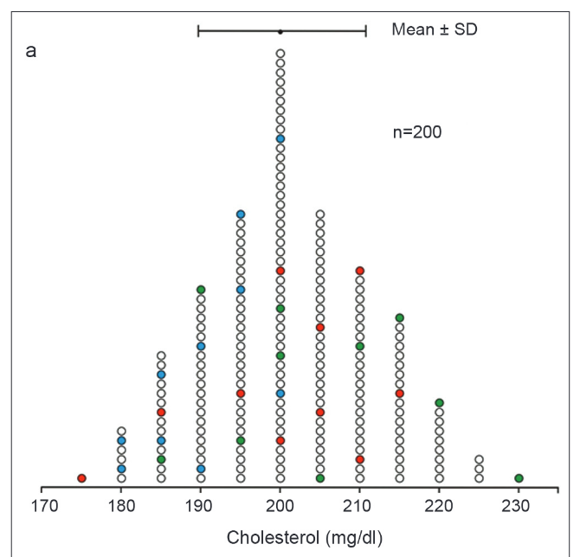
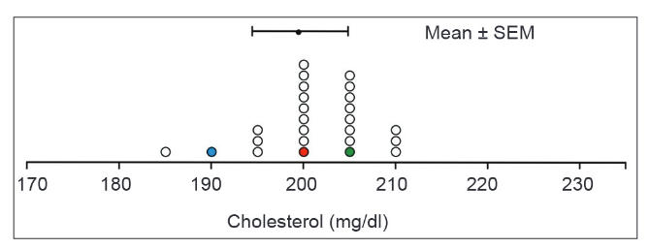
*Supplementary Discussion 2 over SD vs SEM vs CI (During Oct 6 meeting):
Population
3 groups of random selections of samples from the population
Mean values of randomly selected groups
SD
SEM
Notes:
To study the entire population is time and resource intensive and not always feasible; therefore studies are often done on the sample. These findings are further generalized to the larger, unobserved population using inferential statistics.
SD tells us dispersion of individual observations about the mean. a low SD signifies less variability while high SD indicates more spread out of data.
Sample mean ( X ) estimates the true but unknown population mean (μ) and sample SD (s) estimates population SD (s).
However, the precision with which sample results determine population parameters needs to be addressed.
SEM is the standard deviation of mean of random samples drawn from the original population.
This shows that SEM is a measure of the precision with which sample mean X estimate the population mean μ. The precision increases as the sample size increases
However, SEM by itself doesn’t convey much useful information. Its main function is to help construct confidence intervals (CI).
Use of SEM should be limited to compute CI which measures the precision of population estimate.

Slide 5
Question: Is there any difference between the transcellular propagation pattern and morphology of tau aggregates in the mouse with the keto diet vs control?
Features of tau aggregates
Number
Area
Integrated Density
Average
Total
Average
Total
Total/
DAPI
Total/
DAPI
Single
Single
Raw counts
Raw counts/DAPI
Notes:
Number of aggregates per well
Area of aggregates
The average area of aggregates on one well
The total area of aggregates on one well
The total area of aggregates on one well/DAPI
Integrated Density (IntDen) of aggregates
The average IntDen of aggregates on one well
The total IntDen of aggregates on one well
The total IntDen of aggregates on one well/DAPI

Slide 6
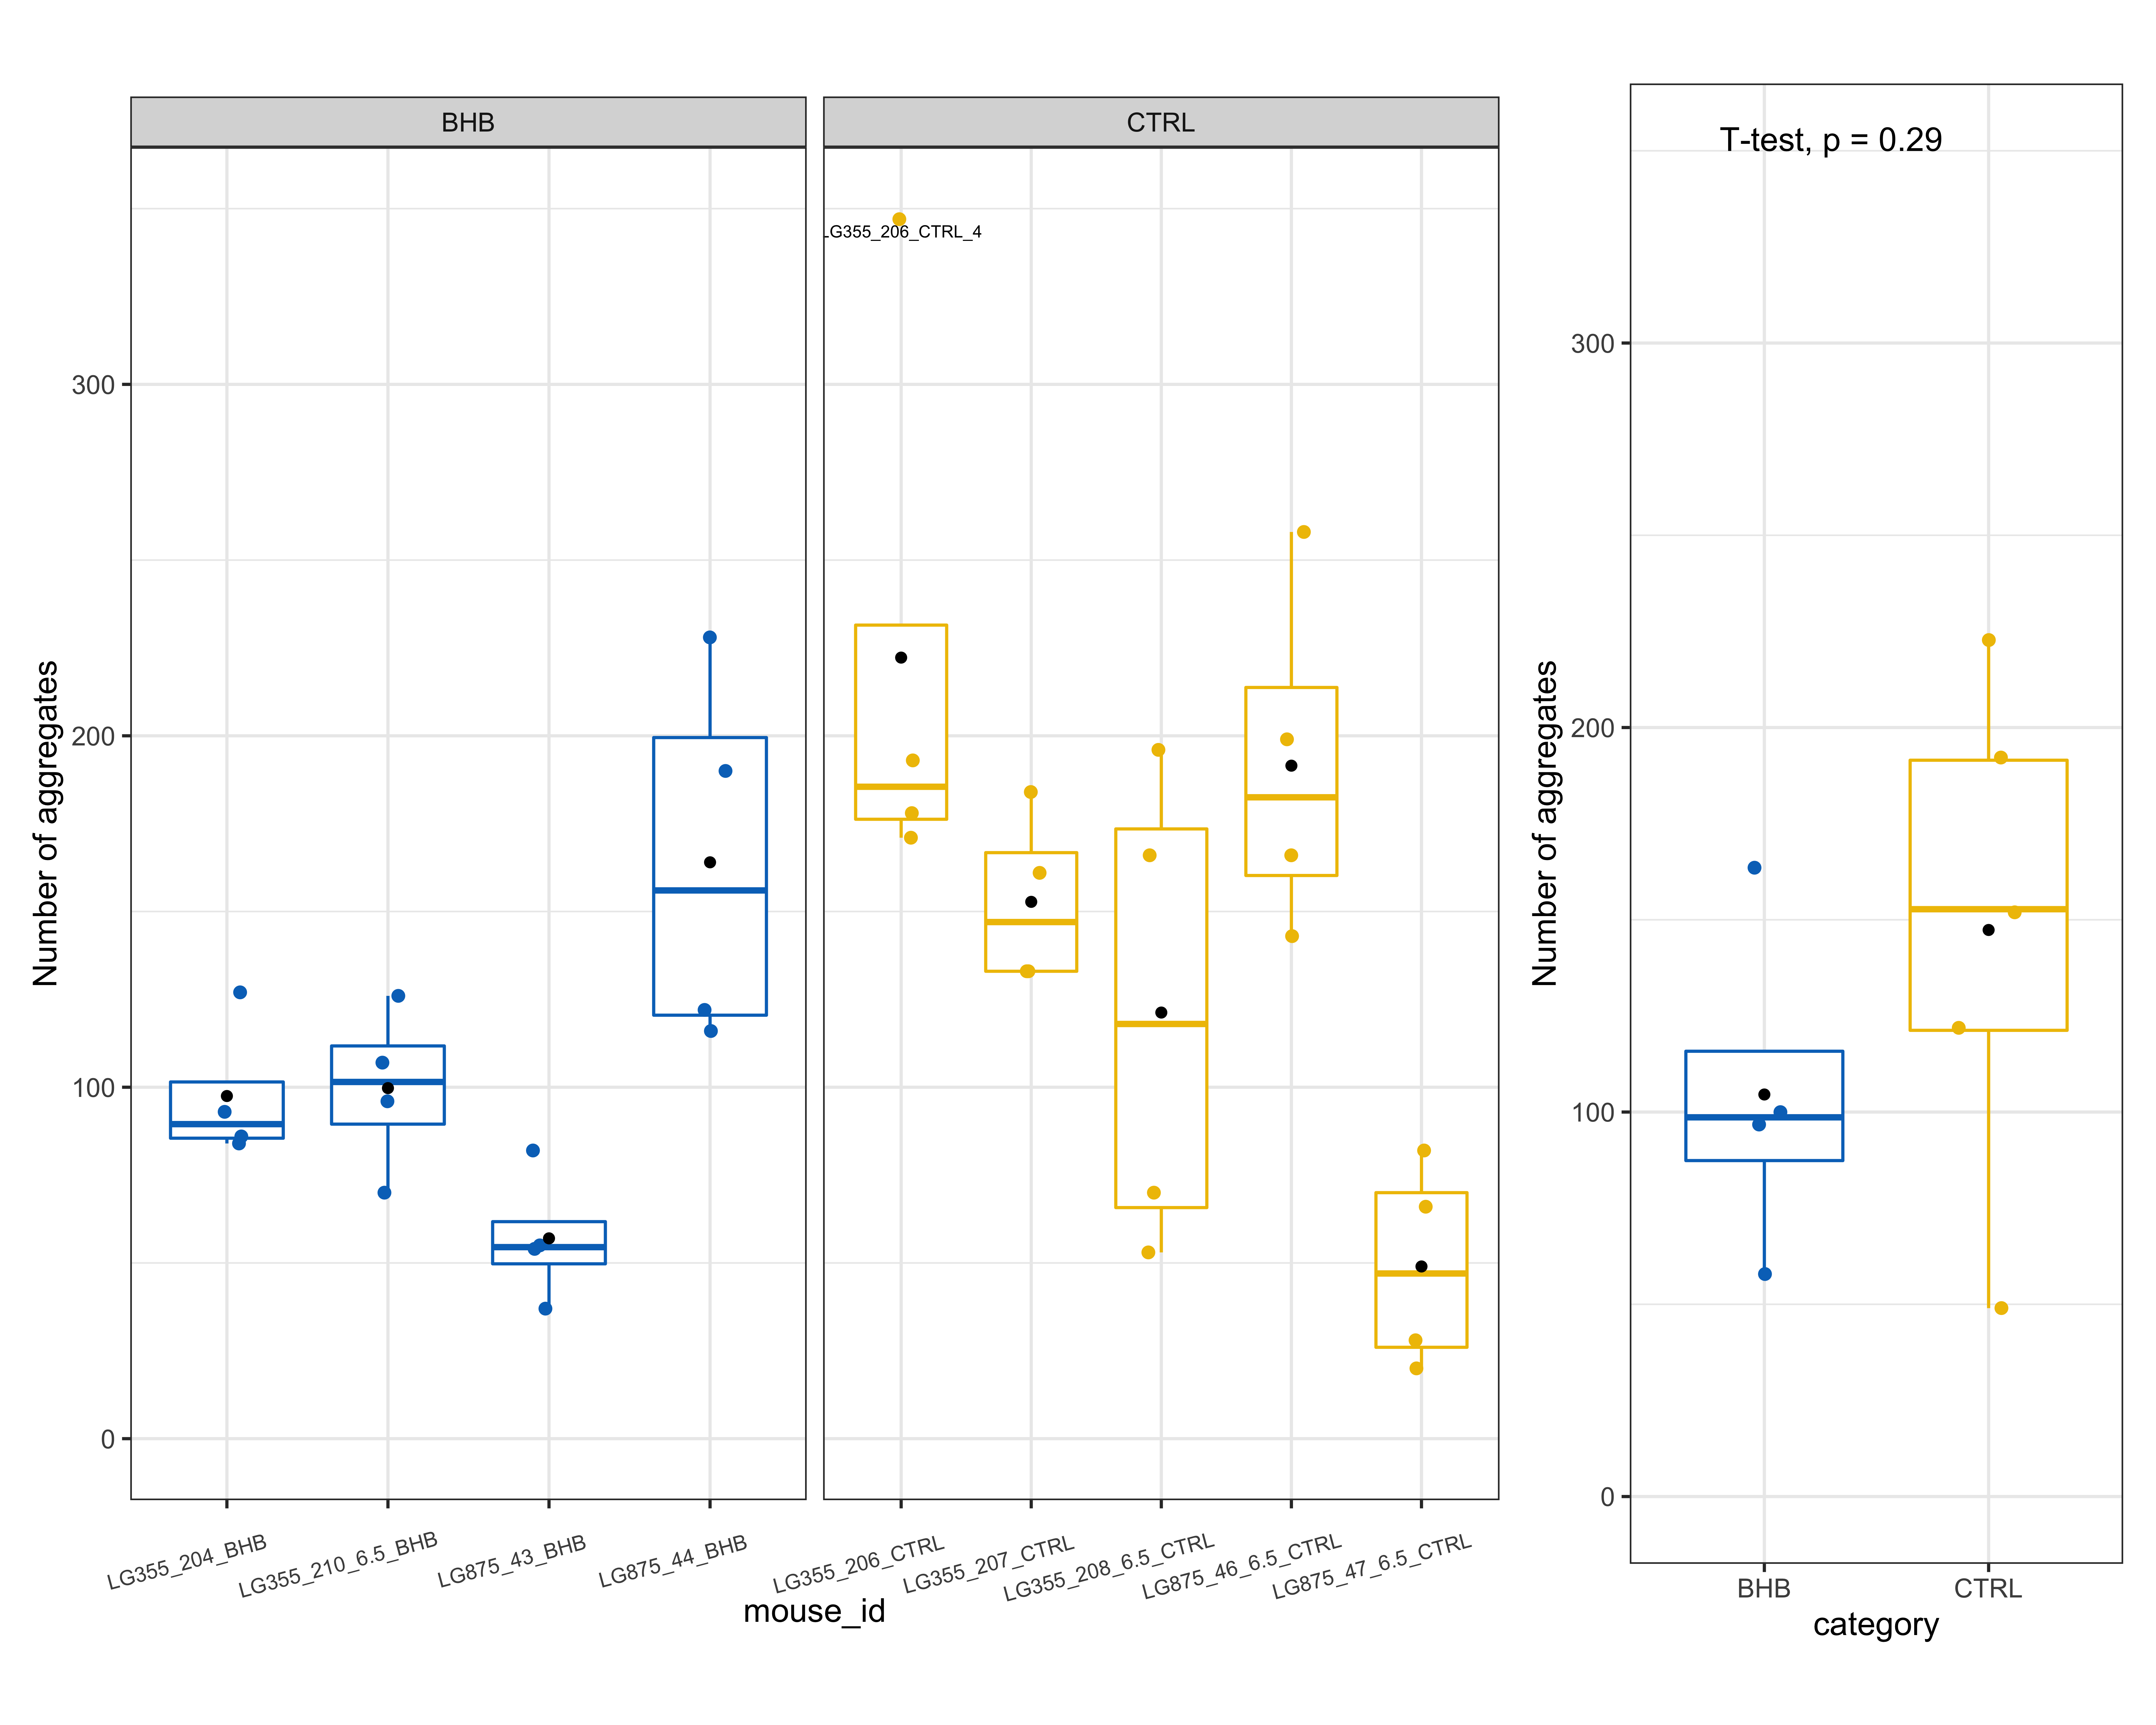
Number of aggregates
(left) per region (right) per mouse

Slide 7
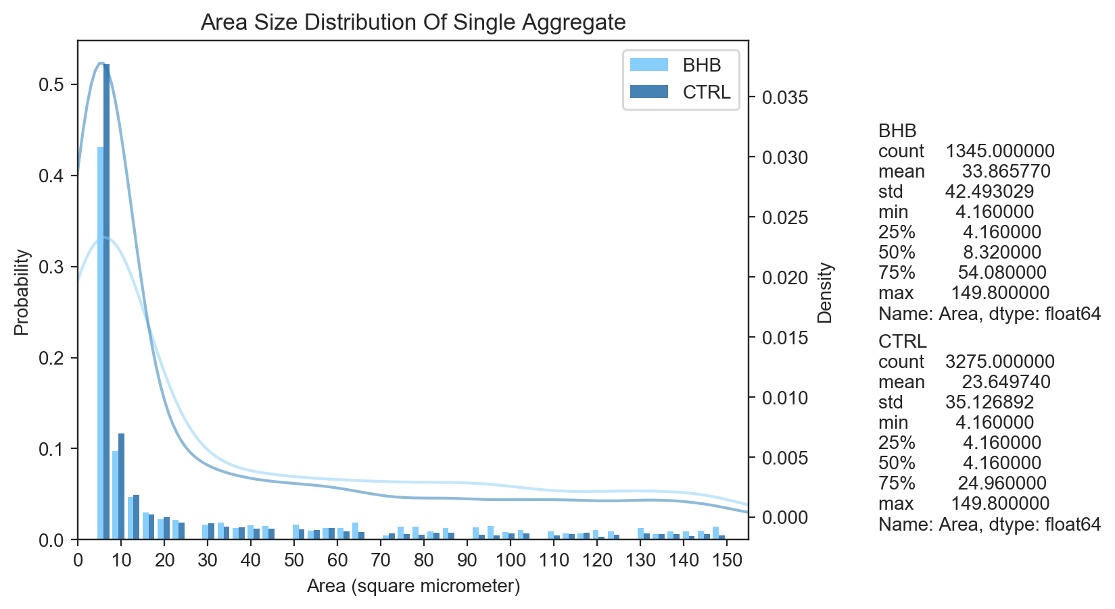

Slide 8
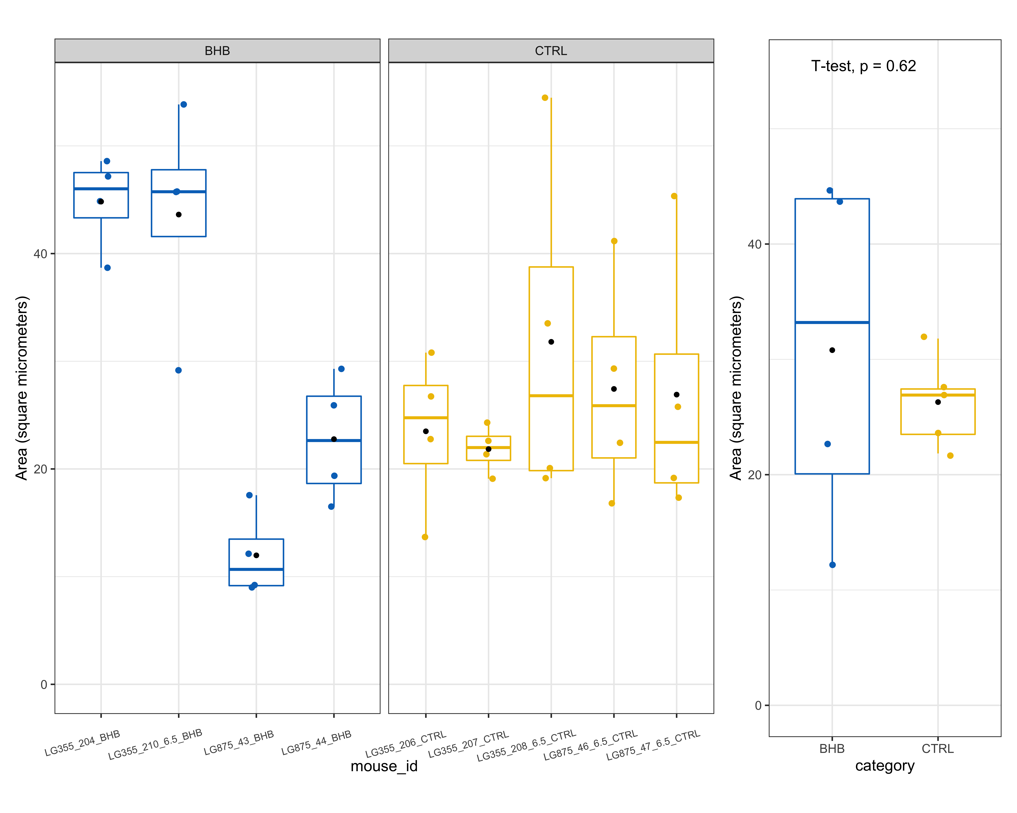
Average area of aggregates
(left) per image (right) per mouse

Slide 9
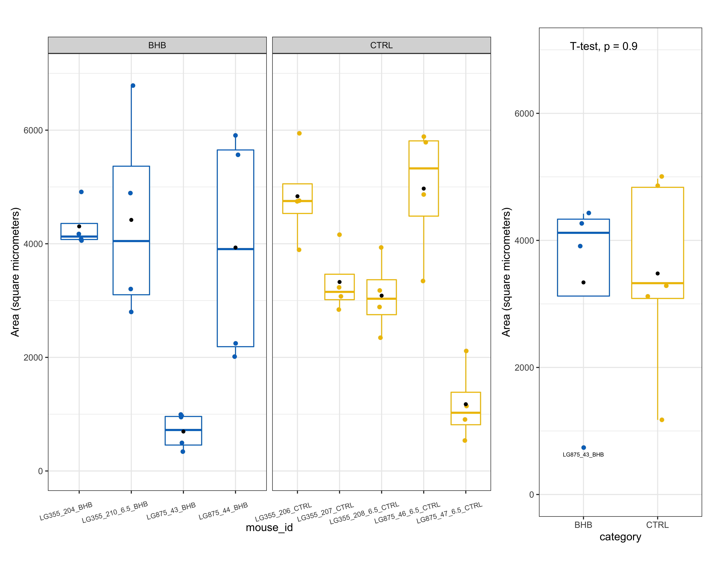
Total area of aggregates on one well
(left) per image (right) per mouse

Slide 10
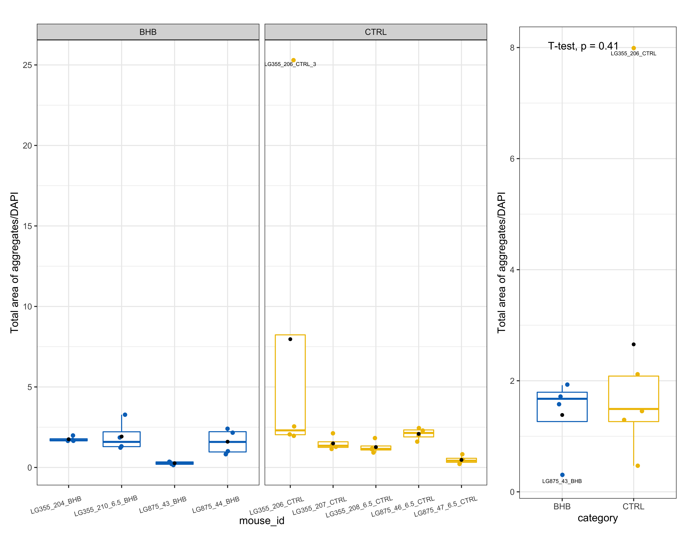
Total area of aggregates on one well/DAPI
(left) per image (right) per mouse

Slide 11
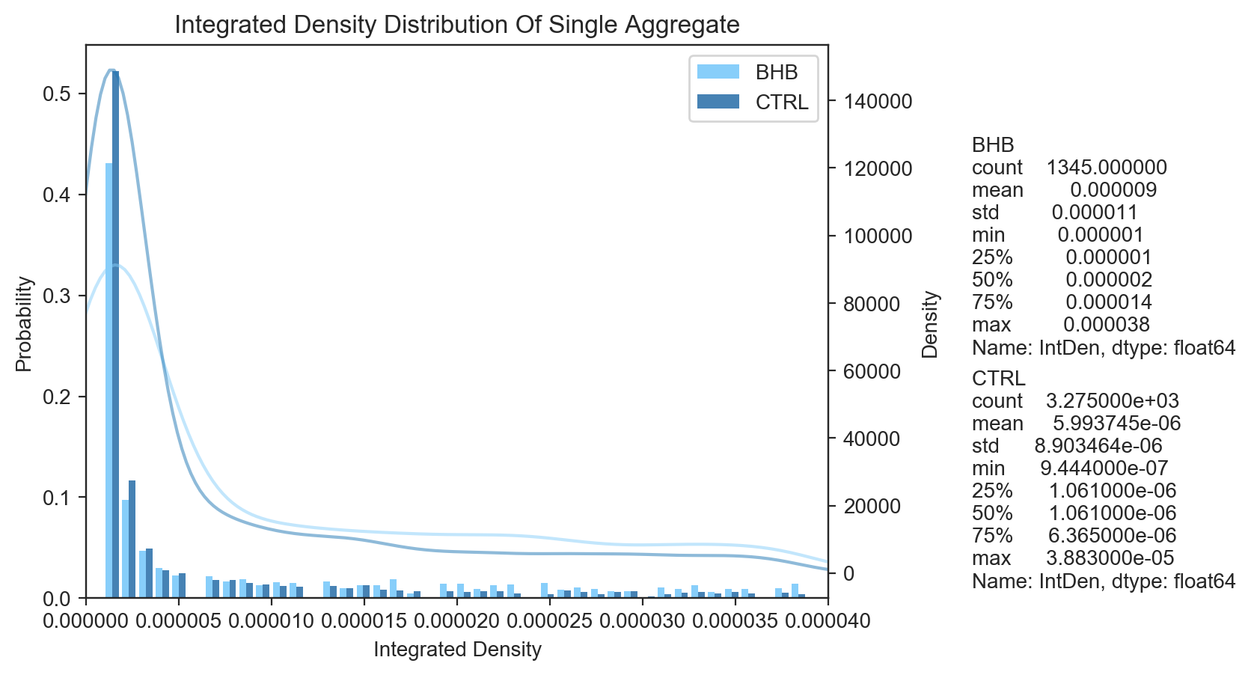

Slide 12
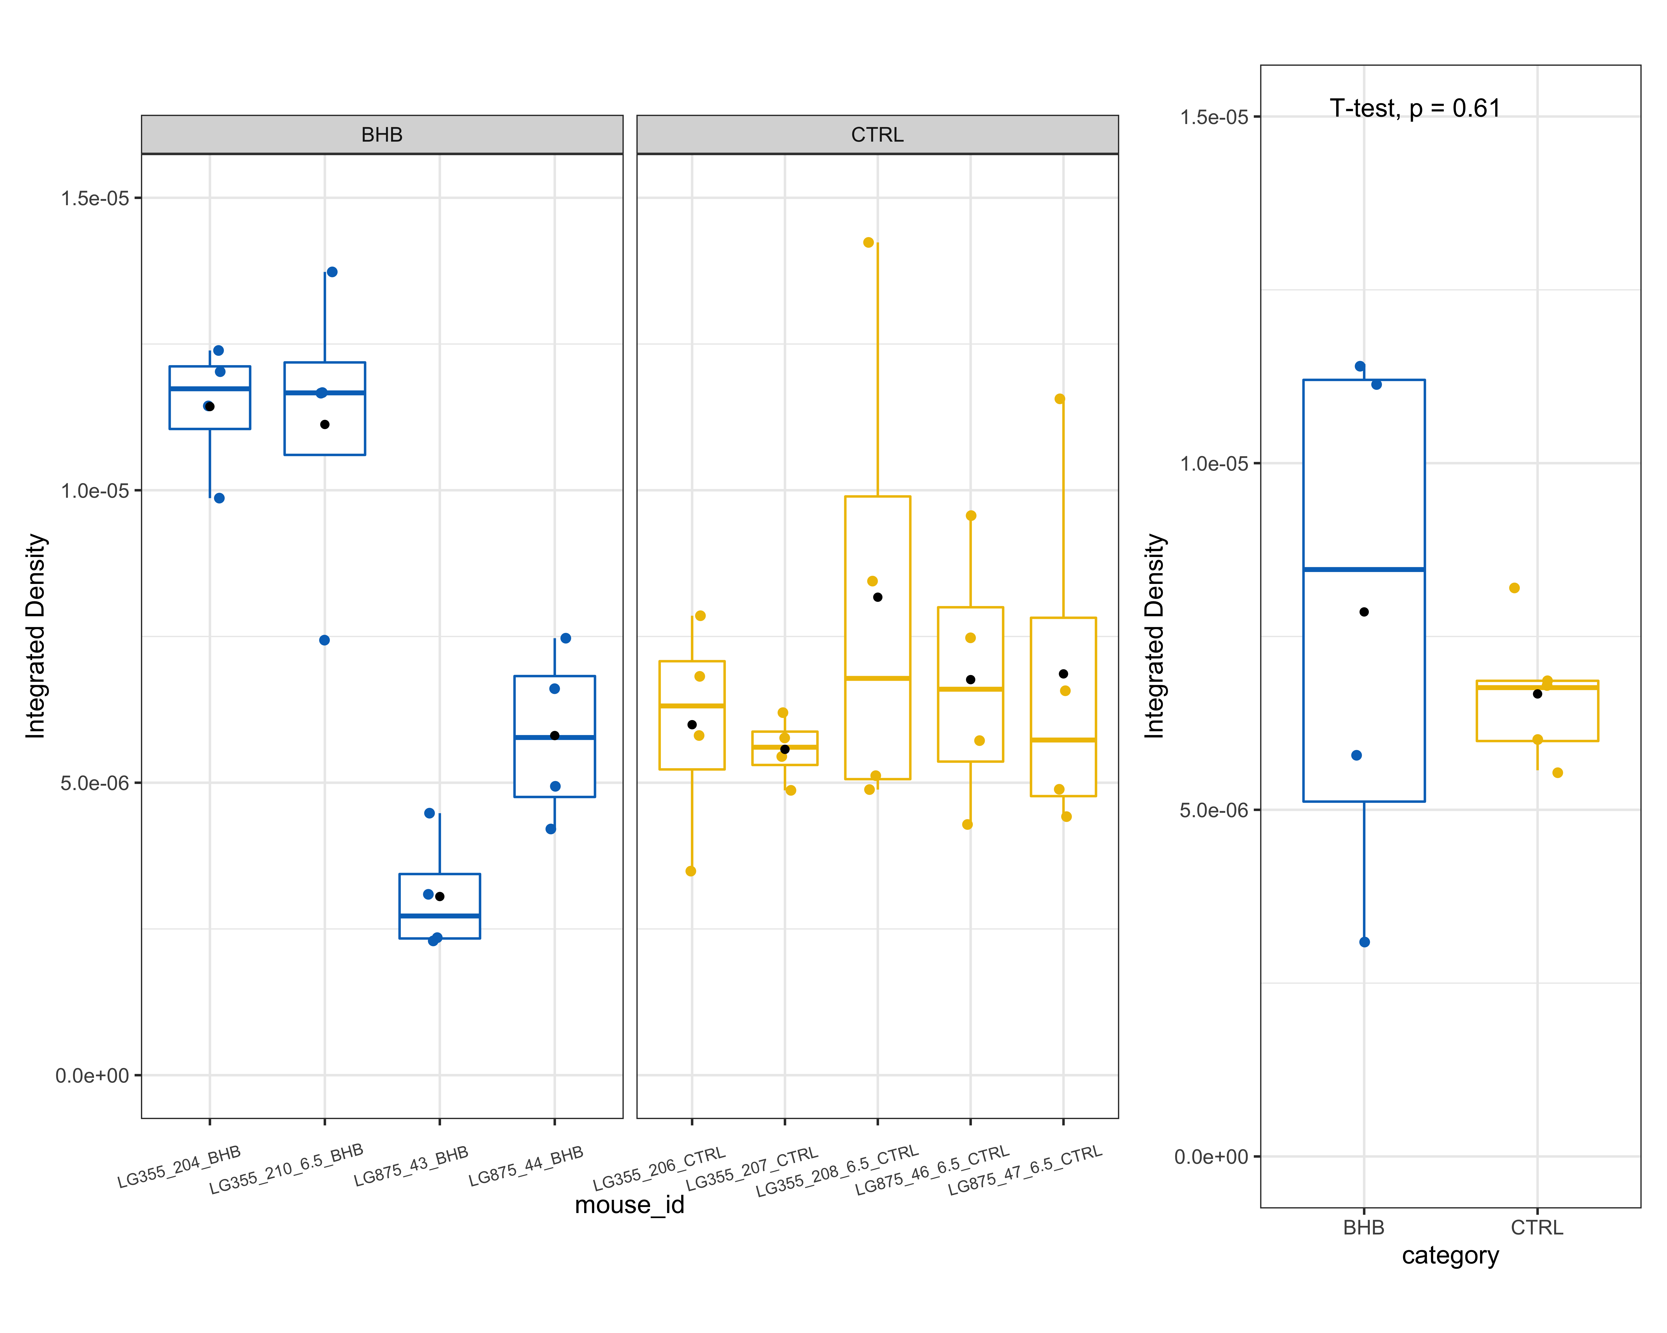
Average IntDen of aggregates
(left) per image (right) per mouse

Slide 13
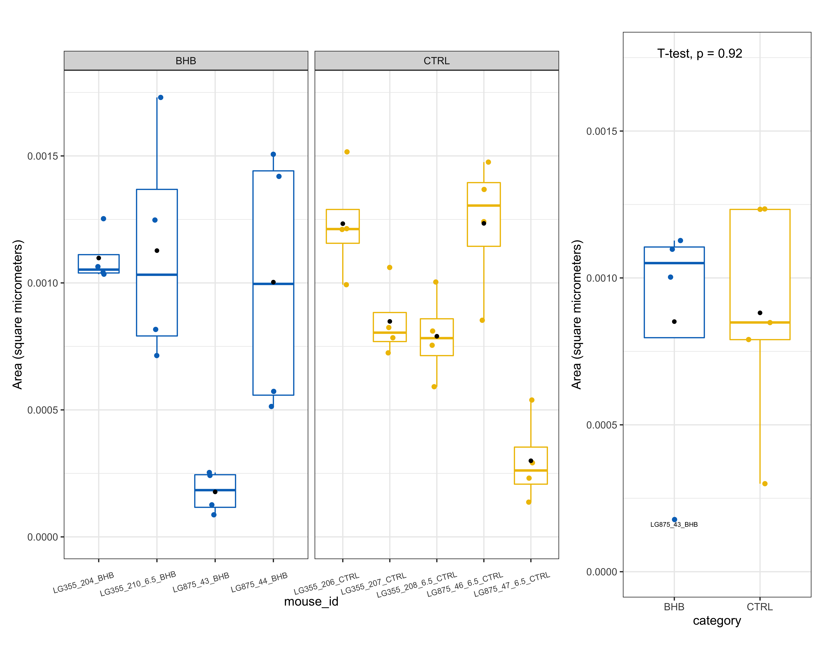
Total IntDen of aggregates on one well
(left) per image (right) per mouse

Slide 14
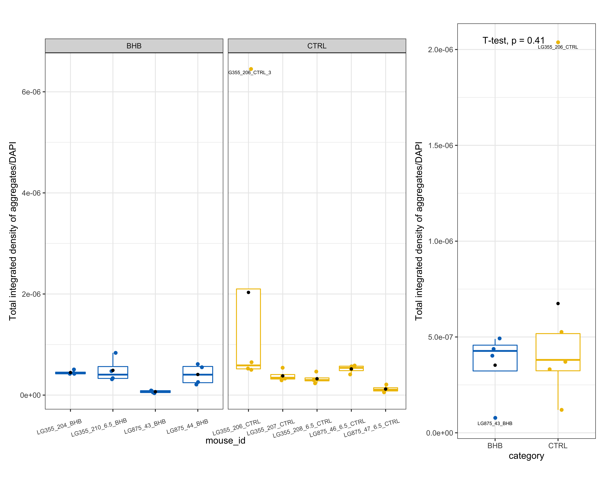
Total IntDen of aggregates on one well/DAPI
(left) per image (right) per mouse

